Slide 1


Business writing in action
SESSION IV: GROUPS & TEAMS (IN) ACTION

Slide 2

LEARNING OBJECTIVES
By the end of this section, you will be able to:
Discuss the role of text messaging in business communication.
Write effective emails for both internal and external communication.
Discuss the purpose and format of a memo.

Slide 3

1. Email
Electronic mail, usually called e-mail
It may be used like text, or synchronous chat, and it can be delivered to a cell phone.

Slide 4
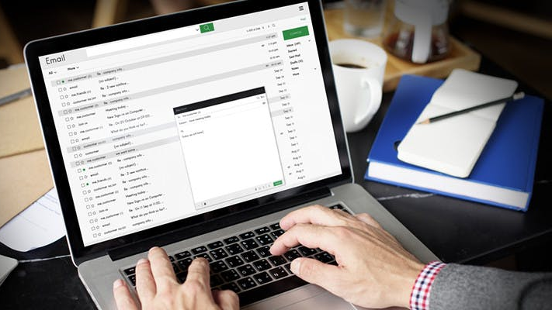
How to write an effective email?
This Photo by Unknown author is licened under CC BY-SA-NC.

Slide 5
How to write an effective email?
1. Proper salutations should demonstrate respect and avoid mix-ups in case a message is accidentally sent to the wrong recipient.
For example, use a salutation like “Dear Ms. X” (external) or “Hi Barry” (internal).

Slide 6
How to write an effective email? (Cont)
2. Subject lines should be clear, brief, and specific. This helps the recipient understand the essence of the message.
For example, “Proposal attached” or “Your question of 10/25.”

Slide 7
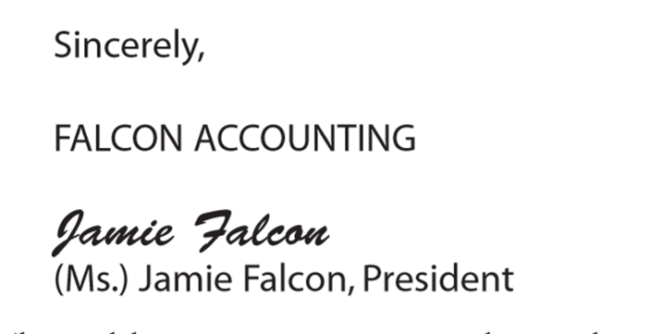
How to write an effective email? (Cont)
3. Close with a signature. Identify yourself by creating a signature block that automatically contains your name and business contact information.

Slide 8
How to write an effective email? (Cont)
4. Avoid abbreviations. An e-mail is not a text message, and the audience may not find your wit cause to ROTFLOL (roll on the floor laughing out loud).
5. Be brief. Omit unnecessary words.

Slide 9
How to write an effective email? (Cont)
6. Use a good format
Include line breaks between sentences or divide your message into brief paragraphs for ease of reading.
A good e-mail should get to the point and conclude in three small paragraphs or less

Slide 10
How to write an effective email? (Cont)
9. Use “Reply All” sparingly
10. Avoid using all caps.
7. Reread, revise, and review.
8. Reply promptly

Slide 11
How to write an effective email? (Cont)
13. Give feedback or follow up.
11. Test links. If you include a link, test it to make sure it is complete.
12. E-mail ahead of time if you are going to attach large files to prevent exceeding the recipient’s mailbox limit or triggering the spam filter.

Slide 12
Activity
Find an example of an e-mail that you wish you had never sent or received. Rewrite it to eliminate the characteristics that you find problematic.
Share it with your classmates.

Slide 13
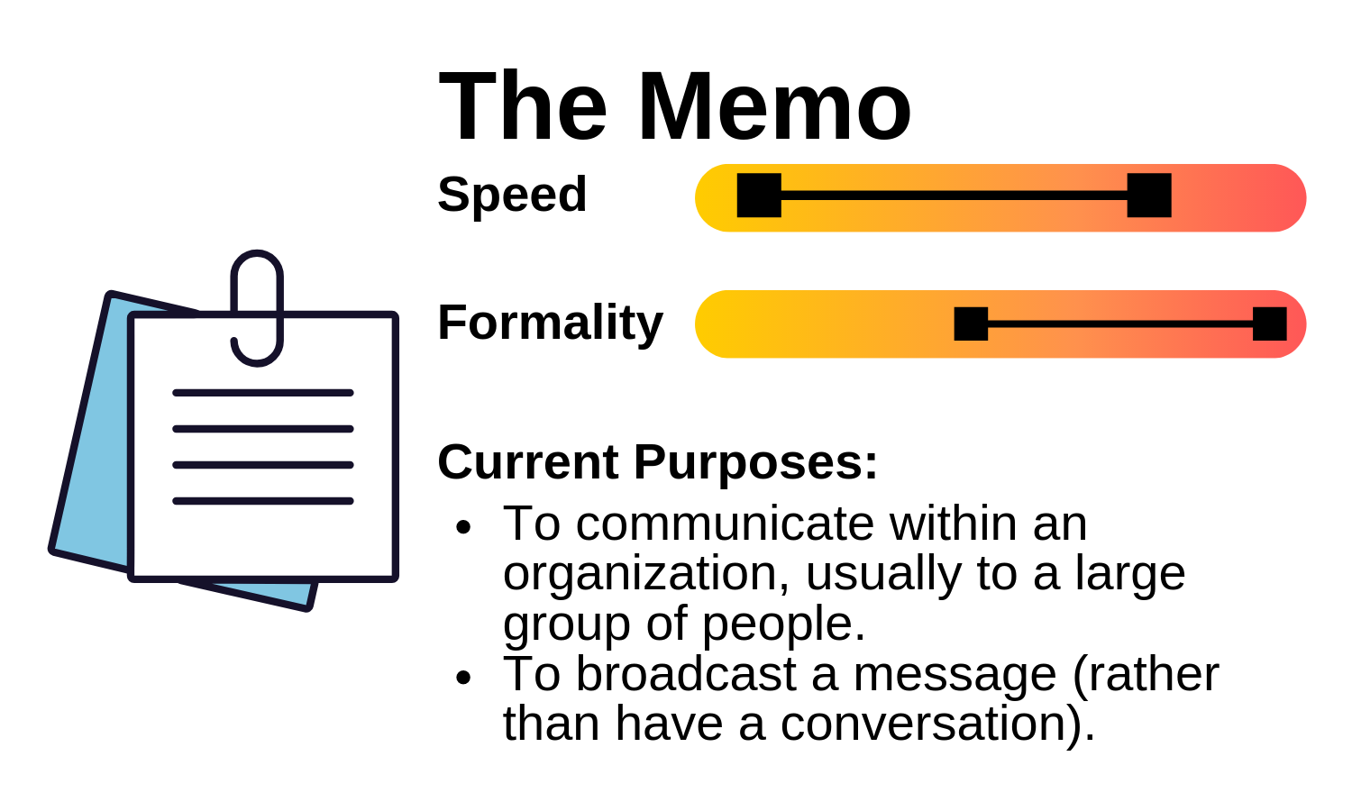
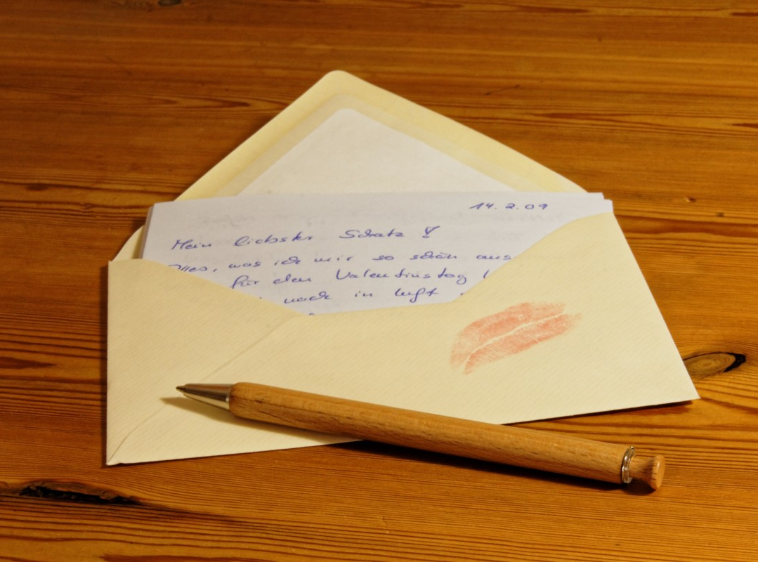
2. Memorandums and Letters
Memos: (or memorandum, meaning “reminder”) is normally used for communicating policies, procedures, or related official business within an organization.
Letters are brief messages sent to recipients that are often outside the organization.

Slide 14
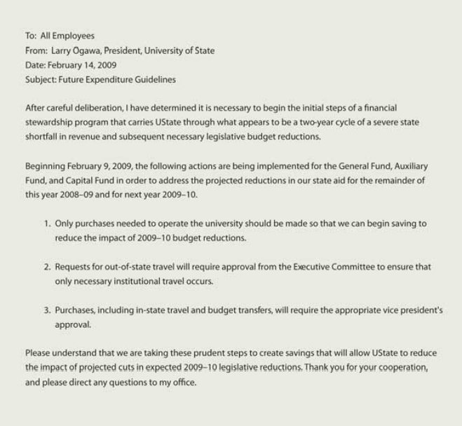
2.1 Memo Format
Use
To:
From:
Date:
Subject:
Writer signs or writes initials near keyed name in the heading

Slide 15
How to write effective Business Memos
Audience Orientation
Professional, Formal Tone
Subject Emphasis
Direct Format
Objectivity

Slide 16
2.2 Elements of a Business Letter
1. Return Address
2. Date
3. Reference (Re:)
4. Delivery (Optional)
5. Recipient Note (Optional)
6. Salutation
7. Introduction
8. Body
9. Conclusion
10. Close
11. Signature
12. Preparation Line
13. Enclosures/ Attachments
14. Courtesy Copies or “CC”
15. Logo/ Contact Information

Slide 17
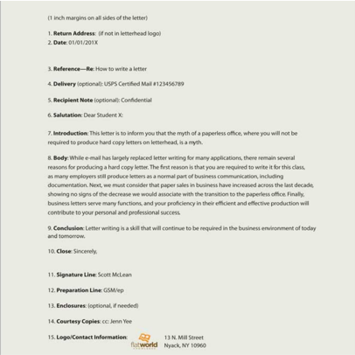

Slide 18
Strategies for Effective Letters
emember that a letter has five main areas:
1. The heading, which establishes the sender, often including address and date
2. The introduction, which establishes the purpose
3. The body, which articulates the message
4. The conclusion, which restates the main point and may include a call to action
5. The signature line, which sometimes includes the contact information

Slide 19
To communicate effectively and project a positive image
• be clear, concise, specific, and respectful;
• each word should contribute to your purpose;
• each paragraph should focus on one idea;
• the parts of the letter should form a complete message;
• the letter should be free of errors.

Slide 20

Exercises
Create a draft letter introducing a product or service to a new client. Post and share with classmates.
Write a memo informing your class that an upcoming holiday will be observed. Post and share with classmates.

Slide 21


